Slide 1
MSP430 USB Setting for FA Tool
hsinmo

Slide 2
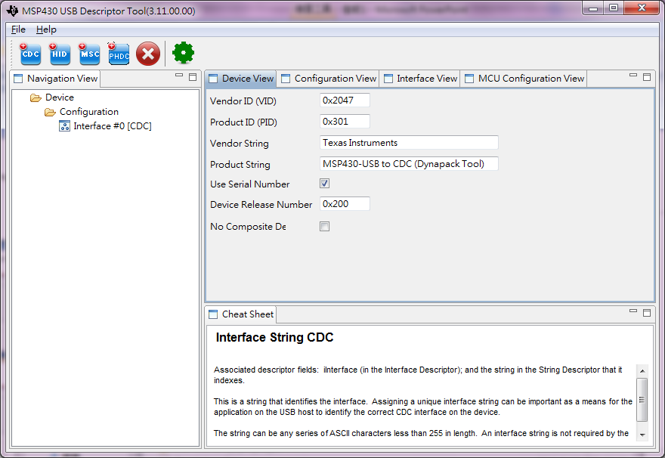
MSP430 USB Descriptor Tool CDC setting
CDC setting at interface #0

Slide 3
Device View at CDC Setting
VID : no change (0x2047)
PID : change num. (for FA tools, it uses 0x301)
Product String:
It will show in 匯流排報告的裝置描述 or Unknow Devices Name.

Slide 4
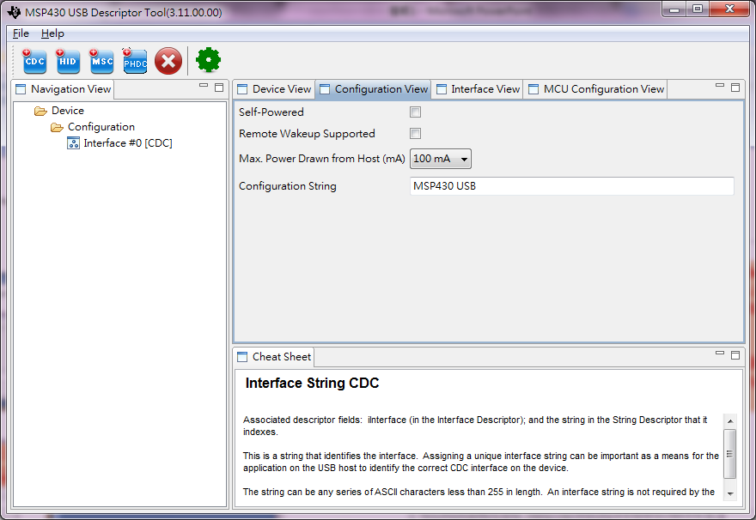
Configuration View at CDC Setting
Use default values no change.

Slide 5
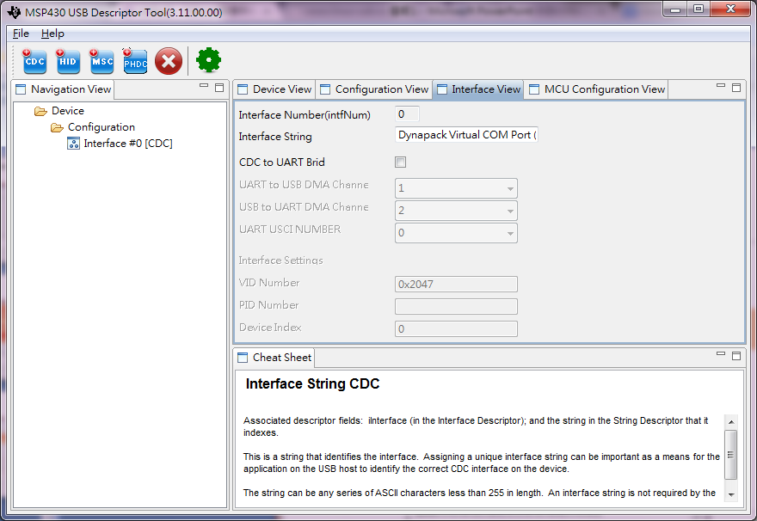
Interface View at CDC Setting
Interface String:
Dynapack Virtual COM Port (CDC)

Slide 6
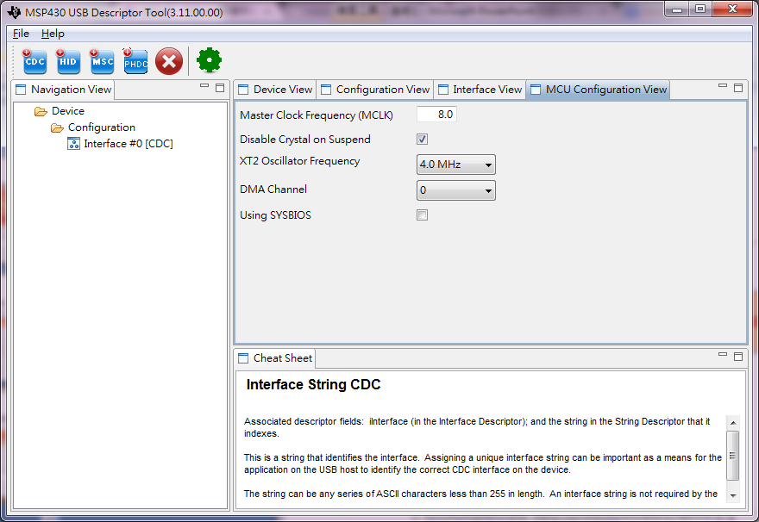
MCU Configuration View at CDC Setting
Use default values no change.

